Slide 1
假设你的英文名为Jack，是英国诺丁汉大学的中国留学生。你负责为在该校就读的32名中国学生筹划圣诞节期间的苏格兰之行，为期7天，请你给诺丁汉的STA(Students’Travel Agency）经理Phil发一封电子邮件，联系有关事宜。要点如下：1）希望能够派车接送；
2）需要一名说标准英语，并非常熟悉苏格兰的导游；
3)请求告知旅行日程及就餐、旅馆、费用等情况；
4）你的联系方式：电话号码：07747745007
注意：1）词数：100词左右；
2）开头和结尾已为你写出，不计入总词数；
3）参考词汇：旅馆住宿accommodation；旅行日程安排 itinerary 长途客车coach

Slide 2





Dear Phil,
I’d like you to organize a trip to Scotland for us. I have here a group of 32 Chinese students studying in Nottingham University, who want to go on a seven-day tour during the Christmas days. I hope we can have a coach which will take us to Scotland and then bring us back to Nottingham. We also need a guide who speaks standard English and knows Scotland well. I would be very grateful if you can work out an itinerary as soon as possible and tell me about our accommodation, meals as well as how much each of us has to pay. If you have any information, please call me at 07747745007. Looking forward to your early reply.
Yours Truly.

Slide 3















【 Address 】 Chaoyang, Beijing People ’ s Republic of China
【 Date 】
To: Embassy and Consulates of United States
Dear Sir/Madame:
We hereby certify that 【 】 , the visa applicant, whose passport number is 【 】 , has been working for 【】 since January 2010 and has heretofore kept a good record of performance. The current title of 【】 is 【】 , and his current salary is s 【】 (CNY 【】 ) per month. 【】 applied for an annual leave of 【】 days from 【】 to 【】 to spend his vacation in your country at his own expense. He will return to his position when vacation is over. We have approved his application and will reserve his position during his leave. Please kindly afford him any appropriate assistance concerning visa affairs. If any questions, please contact us at 【】 .
Sincerely,
Head of HR Department: 【人事部负责人姓名】 【日期】

Slide 4










Dear Sir or Madam:
We hereby confirm that Mr. Zhang San, the visa applicant, whose national passport number is G88888888, has been working for the Department of Education of XX Province (abbreviated to XPDE hereinafter) as a civil servant for fifteen years since July 1993 and has heretofore kept a good record of performance. The current title of Mr. Zhang is Vice-Director of Division of Legal Affairs, XPDE and his current salary (after-tax) is five thousand and five hundred Renminbi yuan (CNY 5,500) per month. Mr. Zhang applied for a leave of 7 days from 1st to 7th October 2008 for his vacation that he planned to spend in your country at his own expense. He assures to comply with UK laws when in your country and return to his position when the vacation is over. We have approved his application and made sure that we will reserve his position and salary during his leave. Please kindly afford him any appropriate assistance concerning visa affairs in case of need. If any questions, please do not hesitate to contact the Division of Personnel, XPDE at +86 (10) 8678-5588 ext. 1234. Sincerely, Division of Personnel Department of Education of XX Province

Slide 5




Furlough Certification
To whom it may concern
Subject: Tourist Visa Application
We certify that Mr. xxxxxxxxx (Passport No.Gxxxxxxx) has been employed by xxxxxxxxxxx Ltd. as a General Manager Assistant since 01/01/2012. We have approved Mr. xxxxxxxxx’s annual leave from 13/08/2012 to 26/08/2012. Moreover We are confident that Mr. Xxxxxxxxx will return to work in China on time, and resume his duties within the company. The purpose of Mr. xxxxxxxxx’s trip is tourism. He will not seek any employment or residency in the UK and will comply with British laws and regulations. We would be very grateful if you would approve Mr. xxxxxxxxxxxxx’s tourist visa application. Please do not hesitate to contact me on xxxxxxxxxxxxxx, if you have any queries.
Best Wishes!
Yours sincerely,
Xxxxxxxxxx Ltd.
ADD：XXXXXXXXXXXXXXXXXXXXXXX Sign by: xxxxxxxxxxxxx Dated:14/05/2012

Slide 6
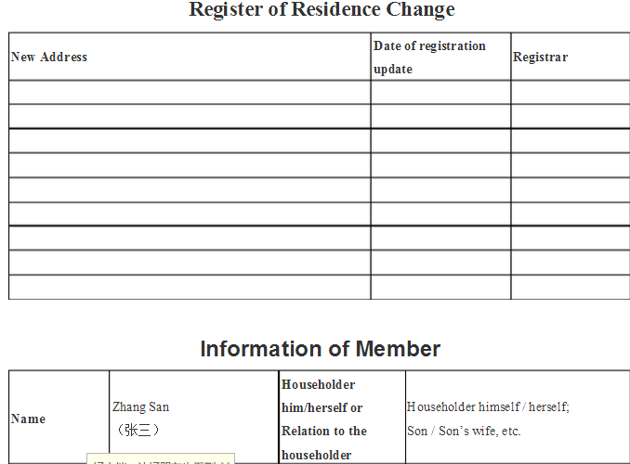





Slide 7
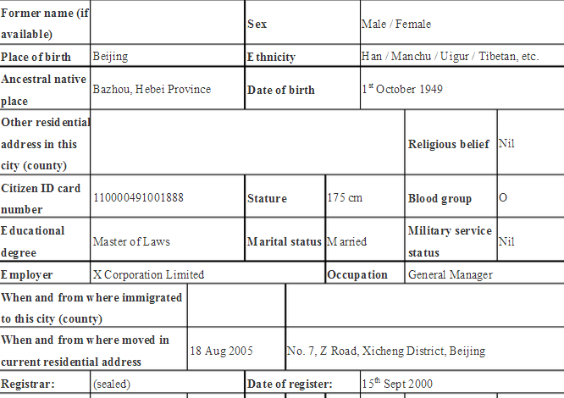












Slide 8
Itinery
4 Oct - Arrive Tokyo, bus tickets airport/hotel and 6 nights Grand Palace Hotel Tokyo
5 Oct - Morning to recover from flight. Afternoon Cityrama Tokyo tour.
10 Oct - Depart Hotel MtFuji/Hakone Tour and 2 nights Mikawaya Ryokan, Hakone
12 Oct - Bus to Odawara Station (not included) for train to Takayama with 2 nights Hida PLaza
14 Oct - Train to Kyoto with 6 nights Rihga Royal Hotel
15 Oct - Kyoto morning tour
20 Oct - Train to Hiroshima and 1 night New Hiroden Hotel
21 Oct - Train/boat to Miyajima and 1 night Iwasou Ryokan
22 Oct - Train to Osaka and 2 nights ANA Hotel
24 Oct - Return flight

Slide 9
Afternoon
The National Mall is home to a host of other museums, including the National Gallery of Art, where the U.S.'s only Leonardo Da Vinci painting hangs, while the National Archives, which houses the original Constitution and Declaration of Independence, is a must for any American history buff.
Evening
Start your evening with dinner at Union Station, where there are a number of sit-down and quick-service restaurants to sample. Plus, the glorious beaux-arts train station is the departure point for tours of the monuments at moonlight offered by Old Town Trolley.
For something a bit quirkier, Bike and Roll, Bike the Big Capital and City Segway Tours (for ages 16 & up) also offer evening tours in season departing from other points in the city. Even if you've made the rounds at all the monuments and memorials by day, there's something extra-special and magical about a nighttime tour.

Slide 10
Day 2
Morning
Head to the Arts District/U Street/Shaw neighborhood for breakfast at a DC institution, Ben's Chili Bowl. Or, if you're visiting on a weekend, visit the colorful farmer's markets at Dupont Circle or Eastern Market on Capitol Hill. The blueberry buckwheat pancakes at Eastern Market are a local favorite.
After breakfast, tour the Capitol Hill neighborhood and explore the U.S. Capitol, Library of Congress and Supreme Court. The neighborhood is also home to the Folger Shakespeare Library, which houses the largest collection of Shakespeare memorabilia outside of England.
For lunch, take Metro to the Downtown/Penn Quarter/Chinatown neighborhood, where you'll find an array of options on 7th Street, near the Verizon Center. Or feast on fresh noodles and flavorful soups in Chinatown. And don't forget to snap a photo of the ornate Friendship Arch that looms over H Street.

Slide 11
Afternoon
Go undercover at the International Spy Museum, where you can crack codes, take on covers and even lead a covert operation. Or stop by the National Portrait Gallery and Smithsonian American Art Museum to see portraits of some of the country's most famous historical figures. For a panoramic view of the city, head to the Old Post Office Pavilion. Free tours are given during the day, and you can peep the official bells of Washington, DC. Animal lovers may also wish to pay a visit to the National Zoo, home to our famous giant pandas, cheetahs, tigers and other exotic species.
Evening
Discover DC's theater scene. The Kennedy Center's Millennium Stage offers free performances at 6:30 p.m. nightly, along with a host of ticketed performances from opera to musicals to jazz. Other theaters, such as the Shakespeare Theatre Company, Arena Stage, Warner Theatre and National Theatre, regularly present familiar classics. For something a bit more contemporary, catch a show at Woolly Mammoth Theatre Company or Studio Theatre.

Slide 12
Day 3
Morning
Start your morning in one of DC's prized neighborhood attractions, like the Anacostia Community Museum, The Phillips Collection, Washington National Cathedral, Tudor Place or Hillwood Museum and Gardens, then head to Georgetown for fantastic shopping and sightseeing in a charming historic setting.
Afternoon
Sports fans can watch the Washington Nationals, Washington Wizards, Washington Mystics, Washington Capitals or D.C. United in action at various venues around town. You can also get in on the action yourself with miles of trails in Rock Creek Park. In addition to trails, the public park has a planetarium, horseback riding and lovely spots for a picnic.
Evening
If your group is looking for nightlife, head to the Arts District/U Street/Shaw neighborhood for live jazz music or Adams Morgan to experience DC's eclectic, international scene. DC's up-and-coming nightlife area, the Atlas District, features a number of funky clubs and restaurants like The H Street Country Club and The Red Palace. For something slightly more low-key, DC boasts a number of wine bars, such as Proof and Cork.

